Slide 1

Computer Vision &
Agentic AI for
Inclusive FinTech
Designing accessible financial technologies for disability and resource-constrained environments
MTN Ghana Tɛkyerɛma Pa Hackathon 2026 - Mentor Session
Prof. Justice Kwame Appati
4 hours • 2 sessions • practical concepts, architectures, and hackathon design patterns
1
Notes:
Slide 1: Use this slide to anchor the discussion in inclusive FinTech, disability support, and resource-constrained environments. Keep examples practical and invite participants to adapt the idea to their hackathon concepts.

Slide 2
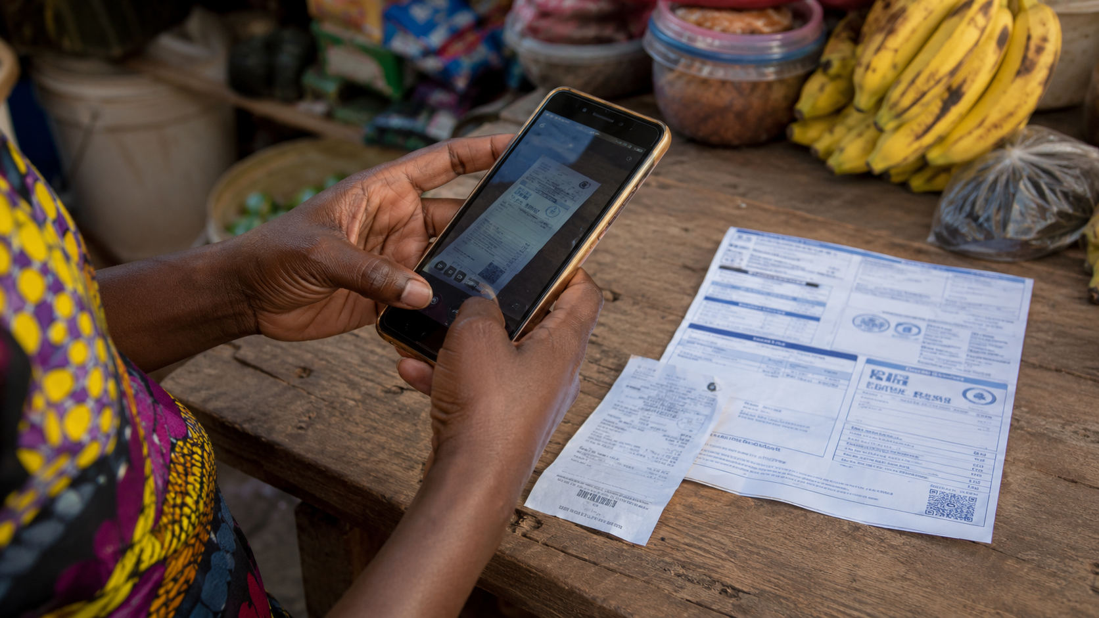
Programme focus
A practical, fintech-first lens: accessibility, disability support, and low-resource deployment.
FinTech
What financial problem are we solving?
Disability & accessibility
Who is excluded by the current interface?
Resource constraints
Can it work on cheap phones, low data, weak networks?
Computer Vision & Agentic AI for Inclusive FinTech
2
Notes:
Slide 2: Use this slide to anchor the discussion in inclusive FinTech, disability support, and resource-constrained environments. Keep examples practical and invite participants to adapt the idea to their hackathon concepts.

Slide 3
Why inclusive fintech needs AI carefully
Financial exclusion often comes from interface, language, device, data, and trust barriers—not only from lack of accounts.
Visual
barriers
Hearing /
speech barriers
Motor
barriers
Literacy /
language barriers
Device /
network barriers
Inclusive AI design asks: who fails, why, and what alternative interaction can the system provide?
Computer Vision & Agentic AI for Inclusive FinTech
4
Notes:
Slide 4: Use this slide to anchor the discussion in inclusive FinTech, disability support, and resource-constrained environments. Keep examples practical and invite participants to adapt the idea to their hackathon concepts.

Slide 4

Core idea: from seeing to acting
Computer Vision perceives financial information. Agentic AI reasons about it and coordinates safe assistance.
Financial world
documents, receipts, ID, forms
Perceive
Computer Vision
Understand
multimodal models
Reason
Agentic AI + tools
Act safely
human checks
MTN x HCI-DCS Hackathon Mentor Material
5
Notes:
Slide 5: Use this slide to anchor the discussion in inclusive FinTech, disability support, and resource-constrained environments. Keep examples practical and invite participants to adapt the idea to their hackathon concepts.

Slide 5
4-hour flow
Two linked sessions: perception first, then reasoning and action.
SESSION 1
Computer Vision for Accessible FinTech
• OCR and document understanding
• Accessible KYC
• Edge AI and model compression
• Bias, data and practical failure modes
SESSION 2
Agentic AI for Inclusive FinTech
• Tool calling and RAG
• Multimodal financial agents
• Low-resource hybrid architectures
• Safety, human-in-the-loop and hackathon MVPs
Computer Vision & Agentic AI for Inclusive FinTech
6
Notes:
Slide 6: Use this slide to anchor the discussion in inclusive FinTech, disability support, and resource-constrained environments. Keep examples practical and invite participants to adapt the idea to their hackathon concepts.

Slide 6
SESSION 1
Computer Vision for Accessible FinTech
Teaching machines to perceive financial information so people can access it differently.
MTN x HCI-DCS Hackathon Mentor Material
7
Notes:
Slide 7: Use this slide to anchor the discussion in inclusive FinTech, disability support, and resource-constrained environments. Keep examples practical and invite participants to adapt the idea to their hackathon concepts.

Slide 7
Start with the user journey
A financial task may be easy for one person and impossible for another.
Can I read it?
Can I position it?
Can I understand it?
Can I verify it?
Can I act on it?
Design question: what support does the AI provide at each failure point?
visual prompts are not enough for blind users
text-only instructions are not enough for low-literacy users
cloud-only AI is not enough for intermittent connectivity
Computer Vision & Agentic AI for Inclusive FinTech
8
Notes:
Slide 8: Use this slide to anchor the discussion in inclusive FinTech, disability support, and resource-constrained environments. Keep examples practical and invite participants to adapt the idea to their hackathon concepts.

Slide 8
Computer Vision as an accessibility layer
Camera captures document
Detect / crop / enhance
OCR extracts text
AI explains meaning
Speech or simple text
The goal is not only to “recognise” the document.
The goal is to make it usable by someone who may not be able to see, read, or navigate it easily.
Computer Vision & Agentic AI for Inclusive FinTech
9
Notes:
Slide 9: Use this slide to anchor the discussion in inclusive FinTech, disability support, and resource-constrained environments. Keep examples practical and invite participants to adapt the idea to their hackathon concepts.

Slide 9

OCR: the basic fintech perception tool
OCR converts text in images into machine-readable text.
Image of bill / receipt
OCR
Structured fields
Amount: GH¢420.50
Due date: 12 Sept
Account: 0049…
Issuer: Utility provider
accessibility: read the document aloud
fintech: extract amounts, dates, references
constraint: OCR may fail with blur, shadows, bad paper or local fonts
Computer Vision & Agentic AI for Inclusive FinTech
10
Notes:
Slide 10: Use this slide to anchor the discussion in inclusive FinTech, disability support, and resource-constrained environments. Keep examples practical and invite participants to adapt the idea to their hackathon concepts.

Slide 10
CV techniques through inclusive-fintech problems
Technique | FinTech use | Inclusion value
OCR | Read bills, receipts, statements | Visual/literacy support
Object detection | Locate ID card, form, face | Guidance for blind users
Document understanding | Extract fields from forms | Cognitive support
Face verification | KYC identity check | Reduce manual review
Anomaly detection | Detect altered documents | Fraud safety
Vision-language models | Explain images naturally | Accessible financial guidance
Computer Vision & Agentic AI for Inclusive FinTech
11
Notes:
Slide 11: Use this slide to anchor the discussion in inclusive FinTech, disability support, and resource-constrained environments. Keep examples practical and invite participants to adapt the idea to their hackathon concepts.

Slide 11
Object detection: “where is it?”
Useful when the system must guide a user, not simply classify an image.
Example: Accessible KYC guidance
“Move the ID card slightly left.”
“Hold still.”
“Lighting is too low.”
“Document captured successfully.”
Detection turns a static camera into an assistive interface.
Computer Vision & Agentic AI for Inclusive FinTech
12
Notes:
Slide 12: Use this slide to anchor the discussion in inclusive FinTech, disability support, and resource-constrained environments. Keep examples practical and invite participants to adapt the idea to their hackathon concepts.

Slide 12
Accessible KYC pipeline
The system should help the user complete the task, not merely reject failed images.
Capture
camera + voice
Guide
position / lighting
OCR
ID fields
Face / liveness
selfie check
Verify
rules + APIs
Human review
low confidence
Inclusive design shift
Hackathon angle
Use audio, haptic and simple-text prompts
Automatically capture when document quality is good
Send uncertain cases to review instead of forcing repeated failure
Prototype only one part: guided capture, document reader, or failure handling
Demonstrate inclusion with a user story, not only a model result
Computer Vision & Agentic AI for Inclusive FinTech
13
Notes:
Slide 13: Use this slide to anchor the discussion in inclusive FinTech, disability support, and resource-constrained environments. Keep examples practical and invite participants to adapt the idea to their hackathon concepts.

Slide 13
Modern Computer Vision stack
Explain enough to choose the right tool; do not over-teach model internals in a hackathon.
Traditional CV
edges, contours, thresholds
CNNs
learn image patterns
Transfer learning
adapt pretrained models
YOLO / detectors
find objects and locations
Vision Transformers
global image reasoning
Vision-language models
image + question → answer
Computer Vision & Agentic AI for Inclusive FinTech
14
Notes:
Slide 14: Use this slide to anchor the discussion in inclusive FinTech, disability support, and resource-constrained environments. Keep examples practical and invite participants to adapt the idea to their hackathon concepts.

Slide 14
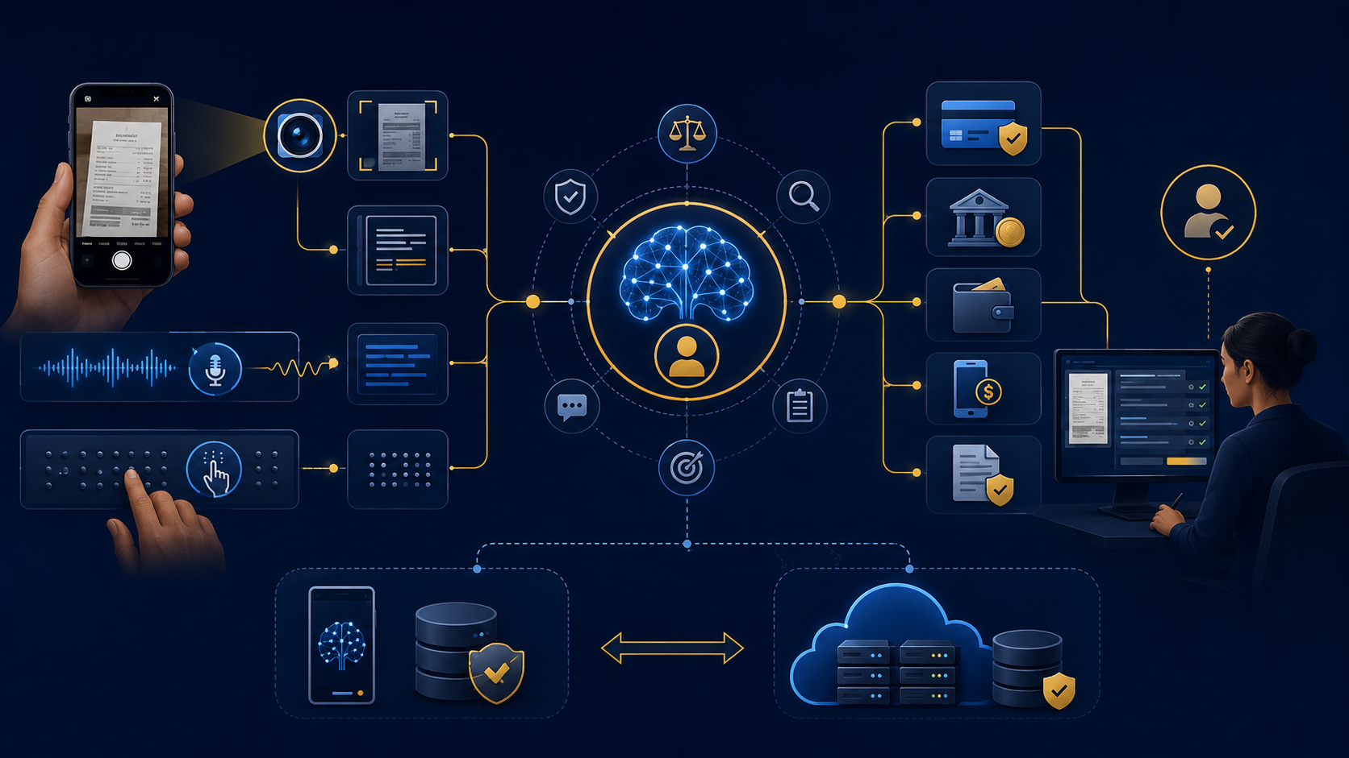
Vision-Language Models
Move from “what is in the image?” to “what does this financial document mean?”
Image + prompt
“What is the amount due?”
“What warning should a low-literacy user hear?”
“Is anything suspicious?”
Session 1 • Computer Vision
15
Notes:
Slide 15: Use this slide to anchor the discussion in inclusive FinTech, disability support, and resource-constrained environments. Keep examples practical and invite participants to adapt the idea to their hackathon concepts.

Slide 15

Resource-constrained environments
A technically excellent model can still fail if it assumes high-end devices and stable connectivity.
Compute
low-end phones, little RAM
Network
slow, expensive, intermittent
Energy
battery and unreliable electricity
Data
small, biased, local datasets
Language
low-resource languages
Infrastructure
limited cloud access
Design rule: every AI feature should have a failure plan.
Computer Vision & Agentic AI for Inclusive FinTech
16
Notes:
Slide 16: Use this slide to anchor the discussion in inclusive FinTech, disability support, and resource-constrained environments. Keep examples practical and invite participants to adapt the idea to their hackathon concepts.

Slide 16
Edge, cloud and hybrid AI
Cloud-first
Phone → Internet → Cloud AI → Internet → Phone
Edge-first
Phone → Local model → Result
Hybrid is usually best for inclusive fintech:
run simple, privacy-sensitive and connectivity-critical tasks locally
send complex reasoning or heavy document analysis to server/cloud when available
queue or degrade gracefully when the network fails
Computer Vision & Agentic AI for Inclusive FinTech
17
Notes:
Slide 17: Use this slide to anchor the discussion in inclusive FinTech, disability support, and resource-constrained environments. Keep examples practical and invite participants to adapt the idea to their hackathon concepts.

Slide 17
Model optimisation: make AI deployable
Advanced techniques introduced practically, not mathematically.
Large model
Quantisation
Pruning
Distillation
TFLite / ONNX
Low-end phone
What participants need to understand
Hackathon choice
smaller can be better for inclusion
reduced bandwidth and cost
faster response for assistive tasks
use pretrained APIs if coding time is short
show an architecture that can later move to edge deployment
Computer Vision & Agentic AI for Inclusive FinTech
18
Notes:
Slide 18: Use this slide to anchor the discussion in inclusive FinTech, disability support, and resource-constrained environments. Keep examples practical and invite participants to adapt the idea to their hackathon concepts.

Slide 18
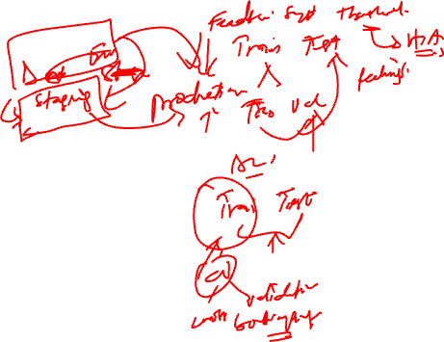
Accuracy can hide exclusion
Overall metrics may conceal who the system fails.
Urban users
98%
High-end phones
99%
Overall accuracy
95%
Rural users
88%
Low-end phones
82%
Accessible design requires subgroup testing: device, disability, language, geography, lighting and document quality.
Computer Vision & Agentic AI for Inclusive FinTech
19
Notes:
Slide 19: Use this slide to anchor the discussion in inclusive FinTech, disability support, and resource-constrained environments. Keep examples practical and invite participants to adapt the idea to their hackathon concepts.

Slide 19
Case study: accessible financial document reader
Scan
Extract
Explain
Confirm
Act / save
Accessible output options
• speech summary
• simplified language
• local language explanation
• large text / high contrast
• human review if unclear
Computer Vision & Agentic AI for Inclusive FinTech
20
Notes:
Slide 20: Use this slide to anchor the discussion in inclusive FinTech, disability support, and resource-constrained environments. Keep examples practical and invite participants to adapt the idea to their hackathon concepts.

Slide 20
Mini design exercise: inclusive KYC on a low-cost phone
Think like a hackathon team: choose the smallest useful AI system.
What runs on device?
What needs Internet?
How does the user receive guidance?
What happens when AI confidence is low?
What data should not leave the phone?
Deliverable: one workflow diagram + one failure plan
Session 1 close
21
Notes:
Slide 21: Use this slide to anchor the discussion in inclusive FinTech, disability support, and resource-constrained environments. Keep examples practical and invite participants to adapt the idea to their hackathon concepts.

Slide 21
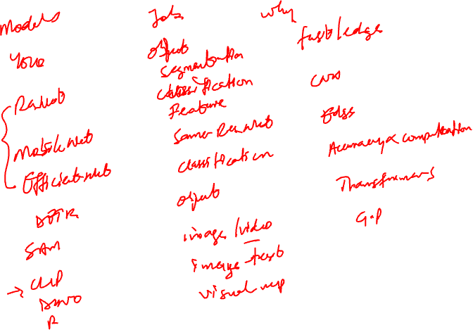

Slide 22
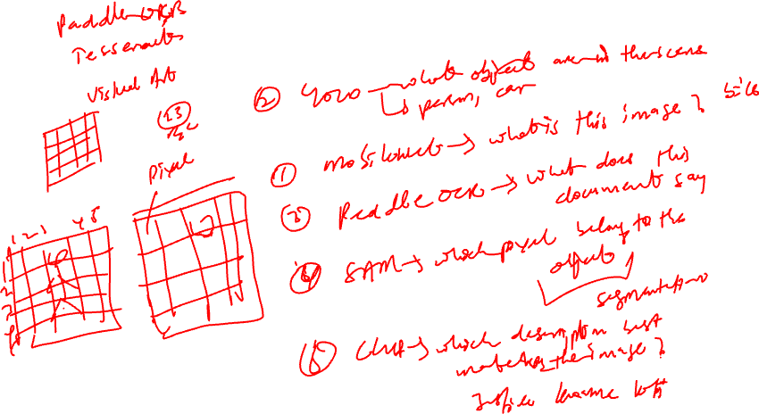

Slide 23
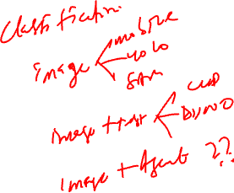

Slide 24
Build for the person who is usually left out.
Inclusive fintech AI succeeds when it improves access, preserves safety, and still works under real-world constraints.
Problem first • AI second • Safety always
Closing
48
Notes:
Slide 48: Use this slide to anchor the discussion in inclusive FinTech, disability support, and resource-constrained environments. Keep examples practical and invite participants to adapt the idea to their hackathon concepts.

